Slide 1
CyberShield Academy
https://cybershield-academy.netlify.app/
https://github.com/Ishtaaa/CyberShield-Intervarsity-Hackathon
By Ishta mahadew

Slide 2
Problem Statement
With the uprise of technology, many businesses' and individual's daily activities are becoming digitized, but they are unaware of the good digital safety practices.
The Critical Gap We Discovered:
- 95% of cyberattacks succeed due to human error, not technical failures
- Traditional training fails - compliance-focused, boring, quickly forgotten
- Skills shortage crisis - 3.5M unfilled cybersecurity jobs globally
- Educational disconnect - theory-heavy curricula vs. practical industry needs

Slide 3
My aim
With the uprise of technology, many business's and individual's daily activities are becoming digitized, but they are unaware of the good digital safety practices.
My aim was to find a new and exciting way for users to learn how to stay safe on the internet. South Africans are rapidly adopting digital services like mobile money, government platforms, and social media. However, they face a critical vulnerability gap - limited awareness of online scams, phishing attacks, and mobile fraud makes them easy targets for cybercriminals

Slide 4
My solution
CyberShield Academy is an innovative, gamified cybersecurity education platform that transforms dry security training into an engaging, interactive adventure. Built as a web-based desktop simulation, it teaches real cybersecurity skills through hands-on experience with authentic attack scenarios and defence strategies.
Gamified Learning: Story-driven missions with XP rewards and level progression
Hands-On Simulation: Use real cybersecurity tools (Gobuster, password analysers) in safe environment
Interactive Desktop: Drag-and-drop windows simulate actual work environments
Immediate Feedback: Learn from mistakes with educational explanations

Slide 5
Core Features & Benefits
Captivating and intriguing Introduction
Nostalgic and familiar with a twist
Story Driven learning journey
- Feature: Narrative follows cyber-detective helping local bakery owner
- Benefit: Emotional connection makes learning memorable and engaging
Real Attack Simulations
Progressive Skill Building
Feature: 3-stage curriculum: Phishing → Web Vulnerabilities → Password Security
Virtual Desktop Environment
Gamified learning system
Interactive Security Challenges

Slide 6
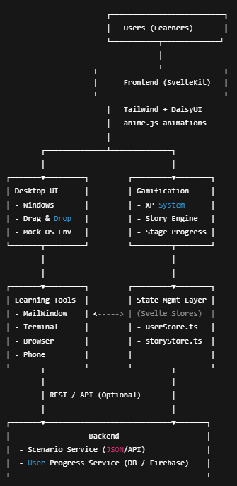
Architecture highlights
Web-Based: No downloads, works in any browser
Desktop-First: Optimized for professional learning environment
Responsive Design: Adapts to different screen sizes
Modern Stack: SvelteKit, TypeScript, TailwindCSS for performance
Interactive Systems: Complex drag-and-drop with smooth animations
State Management: Progressive story system with persistent user progress
Code Quality: Clean, maintainable TypeScript with component architecture

Slide 7
Scalability
Cloud-ready architecture for enterprise deployment
Modular lesson system for easy content expansion
Progress tracking and analytics for institutional use

Slide 8
Technical Sprint Achievements
Technologies Mastered in 24 Hours:
✓ SvelteKit + TypeScript for robust frontend
✓ TailwindCSS + DaisyUI for rapid UI development
✓ GSAP and Anime.js animations for engaging transitions
✓ Drag-and-drop interactions for desktop simulation
✓ Progressive web app architecture
✓ Real-time feedback systems

Slide 9
Innovation and creativity
What Makes Us Unique:
First-of-Kind: Interactive cybersecurity desktop simulation
Narrative Integration: Story-driven learning with memorable characters (Dr. Phish, Hydra-Hack)
Gamification Done Right: XP/leveling system that enhances rather than distracts from learning
Real Tool Simulation: Authentic cybersecurity tool interfaces without complexity barriers

Slide 10
Real-world impact
Addressing Genuine Problems:
Market Size: $45.3B cybersecurity training market
Social Impact: Reducing human error in critical infrastructure
Educational Value: Bridge between academic theory and industry practice
Accessibility: Web-based platform democratizes expensive training
Career Development: Practical skills for high-demand job market

Slide 11
Future improvements
Multiplayer capabilities: Players able to compete and collaborate
AI implementation: AI guidance for users to provide a personalized experience
Accessibility: Different language and mobile support

Slide 12
Demo flow
Intro and Quiz
The app begins with an animated intro; you must wait for the intro after dying in the dinosaur game and a short cybersecurity quiz.
Your score determines your starting XP.
Desktop Simulation
Upon completion of the quiz, you enter a virtual desktop environment.
Main features:
- Phone: Receive mission updates and storyline.
- Mail: Inspect emails, analyse for phishing, and interact with learning content.
- Browser: Simulated for further missions.
- Password Mini-Game: Test password strength interactively.
Progression
Complete tasks to earn XP and level up.
Watch your progress with the XP indicator at the top right.
Interactivity
Drag windows/apps around the desktop.
Buttons and choices provide instant feedback and XP rewards.

